Slide 1
Polling EOT no C8 Retransmissão no C9
Matheus Henrique Schaly

Slide 2
Polling EOT no C8 Retransmissão no C9
Matheus Henrique Schaly

Slide 3
Polling EOT no C8 Retransmissão no C9
Matheus Henrique Schaly

Slide 4
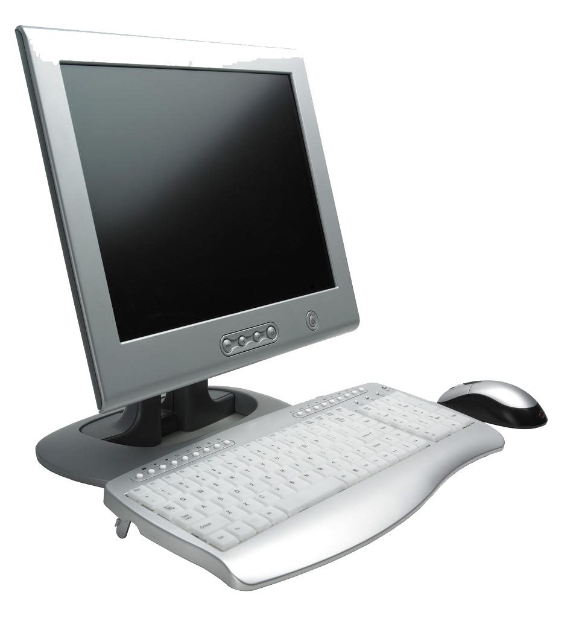



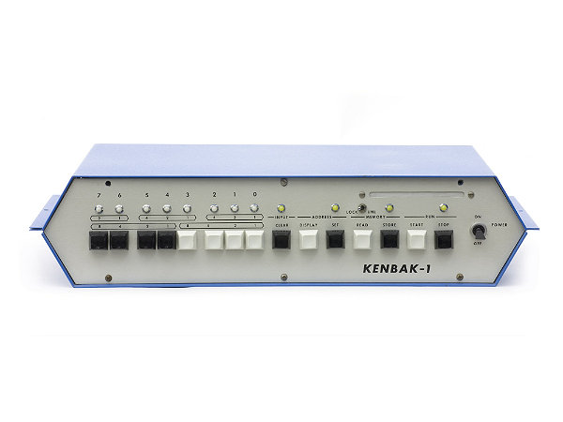
Polling:
Passo 1
C8
C9
DTR(20)
DTR(20)
UDD
CC
MC
MR
C10
C11

Slide 5
Polling:
Passo 1
C8
C9
DTR(20)
DTR(20)
UDD
CC
MC
MR
C10
C11

Slide 6
Polling:
Passo 2
C8
C9
DSR(6)
DSR(6)
UDD
CC
MC
MR
C10
C11

Slide 7
Polling:
Passo 2
C8
C9
DSR(6)
DSR(6)
UDD
CC
MC
MR
C10
C11

Slide 8
Polling:
Passo 3
C8
C9
RTS(4)
UDD
CC
MC
MR
C10
C11

Slide 9
Polling:
Passo 3
C8
C9
RTS(4)
UDD
CC
MC
MR
C10
C11

Slide 10
Polling:
Passo 4
C8
C9
DCD(8)
UDD
CC
MC
MR
C10
C11

Slide 11
Polling:
Passo 4
C8
C9
DCD(8)
UDD
CC
MC
MR
C10
C11

Slide 12
Polling:
Passo 5
C8
C9
CTS(5)
UDD
CC
MC
MR
C10
C11

Slide 13
Polling:
Passo 5
C8
C9
CTS(5)
UDD
CC
MC
MR
C10
C11

Slide 14
Polling:
Passo 6
C8
C9
C8, quer
transmitir?
DT(2)
UDD
CC
MC
MR
C10
C11

Slide 15
Polling:
Passo 6
C8
C9
C8, quer
transmitir?
DT(2)
UDD
ENQ | POL | C8 | EOT
CC
MC
MR
C10
C11

Slide 16
Polling:
Passo 7
C8
C9
RD(3)
UDD
ENQ | POL | C8 | EOT
CC
MC
MR
C10
C11

Slide 17
Polling:
Passo 7
C8
C9
RD(3)
UDD
ENQ | POL | C8 | EOT
CC
MC
MR
C10
C11

Slide 18
Polling:
Passo 8
C8
C9
RTS(4)
UDD
CC
MC
MR
C10
C11

Slide 19
Polling:
Passo 8
C8
C9
RTS(4)
UDD
CC
MC
MR
C10
C11

Slide 20
Polling:
Passo 9
C8
C9
DCD(8)
UDD
CC
MC
MR
C10
C11

Slide 21
Polling:
Passo 9
C8
C9
DCD(8)
UDD
CC
MC
MR
C10
C11

Slide 22
Polling:
Passo 10
C8
C9
CTS(5)
UDD
CC
MC
MR
C10
C11

Slide 23
Polling:
Passo 10
C8
C9
CTS(5)
UDD
CC
MC
MR
C10
C11

Slide 24
Polling:
Passo 11
Não
C8
C9
DT(2)
UDD
CC
MC
MR
C10
C11

Slide 25
Polling:
Passo 11
Não
C8
C9
DT(2)
UDD
EOT
CC
MC
MR
C10
C11

Slide 26
Polling:
Passo 12
C8
C9
RD(3)
UDD
EOT
CC
MC
MR
C10
C11

Slide 27
Polling:
Passo 12
C8
C9
RD(3)
UDD
EOT
CC
MC
MR
C10
C11

Slide 28
Polling:
Passo 13
C8
C9
RTS(4)
UDD
CC
MC
MR
C10
C11

Slide 29
Polling:
Passo 13
C8
C9
RTS(4)
UDD
CC
MC
MR
C10
C11

Slide 30
Polling:
Passo 14
C8
C9
DCD(8)
UDD
CC
MC
MR
C10
C11

Slide 31
Polling:
Passo 14
C8
C9
DCD(8)
UDD
CC
MC
MR
C10
C11

Slide 32
Polling:
Passo 15
C8
C9
CTS(5)
UDD
CC
MC
MR
C10
C11

Slide 33
Polling:
Passo 15
C8
C9
CTS(5)
UDD
CC
MC
MR
C10
C11

Slide 34
Polling:
Passo 16
C8
C9
C9, quer
transmitir?
DT(2)
UDD
CC
MC
MR
C10
C11

Slide 35
Polling:
Passo 16
C8
C9
C9, quer
transmitir?
DT(2)
UDD
CC
MC
MR
C10
C11

Slide 36
Polling:
Passo 17
C8
C9
RD(3)
UDD
ENQ | POL | C9 | EOT
CC
MC
MR
C10
C11

Slide 37
Polling:
Passo 17
C8
C9
RD(3)
UDD
ENQ | POL | C9 | EOT
CC
MC
MR
C10
C11

Slide 38
Polling:
Passo 18
C8
C9
RTS(4)
UDD
CC
MC
MR
C10
C11

Slide 39
Polling:
Passo 18
C8
C9
RTS(4)
UDD
CC
MC
MR
C10
C11

Slide 40
Polling:
Passo 19
C8
C9
DCD(8)
UDD
CC
MC
MR
C10
C11

Slide 41
Polling:
Passo 19
C8
C9
DCD(8)
UDD
CC
MC
MR
C10
C11

Slide 42
Polling:
Passo 20
C8
C9
CTS(5)
UDD
CC
MC
MR
C10
C11

Slide 43
Polling:
Passo 20
C8
C9
CTS(5)
UDD
CC
MC
MR
C10
C11

Slide 44
Polling:
Passo 21
C8
C9
Sim, eis
a mensagem
DT(2)
UDD
CC
MC
MR
C10
C11

Slide 45
Polling:
Passo 21
C8
C9
Sim, eis
a mensagem
DT(2)
UDD
SOH | C9 | STX | TEXTO | ETC | BCC
CC
MC
MR
C10
C11

Slide 46
Polling:
Passo 22
C8
C9
RD(3)
UDD
SOH | C9 | STX | TEXTO | ETC | BCC
CC
MC
MR
C10
C11

Slide 47
Polling:
Passo 22
C8
C9
RD(3)
UDD
SOH | C9 | STX | TEXTO | ETC | BCC
CC
MC
MR
C10
C11

Slide 48
Polling:
Passo 23
C8
C9
RTS(4)
UDD
CC
MC
MR
C10
C11

Slide 49
Polling:
Passo 23
C8
C9
RTS(4)
UDD
CC
MC
MR
C10
C11

Slide 50
Polling:
Passo 24
C8
C9
DCD(8)
UDD
CC
MC
MR
C10
C11

Slide 51
Polling:
Passo 24
C8
C9
DCD(8)
UDD
CC
MC
MR
C10
C11

Slide 52
Polling:
Passo 25
C8
C9
CTS(5)
UDD
CC
MC
MR
C10
C11

Slide 53
Polling:
Passo 25
C8
C9
CTS(5)
UDD
CC
MC
MR
C10
C11

Slide 54
Polling:
Passo 26
C8
C9
DT(2)
UDD
CC
MC
MR
C10
C11

Slide 55
Polling:
Passo 27
C8
C9
DT(2)
UDD
NACK
CC
MC
MR
C10
C11

Slide 56
Polling:
Passo 28
C8
C9
RD(3)
UDD
NACK
CC
MC
MR
C10
C11

Slide 57
Polling:
Passo 28
C8
C9
RD(3)
UDD
NACK
CC
MC
MR
C10
C11

Slide 58
Polling:
Passo 29
C8
C9
RTS(4)
UDD
CC
MC
MR
C10
C11

Slide 59
Polling:
Passo 29
C8
C9
RTS(4)
UDD
CC
MC
MR
C10
C11

Slide 60
Polling:
Passo 30
C8
C9
DCD(8)
UDD
CC
MC
MR
C10
C11

Slide 61
Polling:
Passo 30
C8
C9
DCD(8)
UDD
CC
MC
MR
C10
C11

Slide 62
Polling:
Passo 31
C8
C9
CTS(5)
UDD
CC
MC
MR
C10
C11

Slide 63
Polling:
Passo 31
C8
C9
CTS(5)
UDD
CC
MC
MR
C10
C11

Slide 64
Polling:
Passo 32
C8
C9
Retransmitindo
DT(2)
UDD
CC
MC
MR
C10
C11

Slide 65
Polling:
Passo 32
C8
C9
Retransmitindo
DT(2)
UDD
SOH | C9 | STX | TEXTO | ETC | BCC
CC
MC
MR
C10
C11

Slide 66
Polling:
Passo 33
C8
C9
RD(3)
UDD
SOH | C9 | STX | TEXTO | ETC | BCC
CC
MC
MR
C10
C11

Slide 67
Polling:
Passo 33
C8
C9
RD(3)
UDD
SOH | C9 | STX | TEXTO | ETC | BCC
CC
MC
MR
C10
C11

Slide 68
Polling:
Passo 34
C8
C9
RTS(4)
UDD
CC
MC
MR
C10
C11

Slide 69
Polling:
Passo 34
C8
C9
RTS(4)
UDD
CC
MC
MR
C10
C11

Slide 70
Polling:
Passo 35
C8
C9
DCD(8)
UDD
CC
MC
MR
C10
C11

Slide 71
Polling:
Passo 35
C8
C9
DCD(8)
UDD
CC
MC
MR
C10
C11

Slide 72
Polling:
Passo 36
C8
C9
CTS(5)
UDD
CC
MC
MR
C10
C11

Slide 73
Polling:
Passo 36
C8
C9
CTS(5)
UDD
CC
MC
MR
C10
C11

Slide 74
Polling:
Passo 37
C8
C9
DT(2)
UDD
CC
MC
MR
C10
C11

Slide 75
Polling:
Passo 37
C8
C9
DT(2)
UDD
ACK
CC
MC
MR
C10
C11

Slide 76
Polling:
Passo 38
C8
C9
RD(3)
UDD
ACK
CC
MC
MR
C10
C11

Slide 77
Polling:
Passo 38
C8
C9
RD(3)
UDD
ACK
CC
MC
MR
C10
C11

Slide 78
Polling:
Passo 39
C8
C9
RTS(4)
UDD
CC
MC
MR
C10
C11

Slide 79
Polling:
Passo 39
C8
C9
RTS(4)
UDD
CC
MC
MR
C10
C11

Slide 80
Polling:
Passo 40
C8
C9
DCD(8)
UDD
CC
MC
MR
C10
C11

Slide 81
Polling:
Passo 40
C8
C9
DCD(8)
UDD
CC
MC
MR
C10
C11

Slide 82
Polling:
Passo 41
C8
C9
CTS(5)
UDD
CC
MC
MR
C10
C11

Slide 83
Polling:
Passo 41
C8
C9
CTS(5)
UDD
CC
MC
MR
C10
C11

Slide 84
Polling:
Passo 42
C8
C9
DT(2)
UDD
CC
MC
MR
C10
C11

Slide 85
Polling:
Passo 42
C8
C9
DT(2)
UDD
EOT
CC
MC
MR
C10
C11

Slide 86
Polling:
Passo 43
C8
C9
RD(3)
UDD
EOT
CC
MC
MR
C10
C11

Slide 87
Polling:
Passo 43
C8
C9
RD(3)
UDD
EOT
CC
MC
MR
C10
C11

Slide 88
Selection Time Out no C10 Retransmissão no C11
Matheus Henrique Schaly

Slide 89
Selection Time Out no C10 Retransmissão no C11
Matheus Henrique Schaly

Slide 90
Selection Time Out no C10 Retransmissão no C11
Matheus Henrique Schaly

Slide 91
Selection:
Passo 1
C8
C9
RTS(4)
UDD
CC
MC
MR
C10
C11

Slide 92
Selection:
Passo 1
C8
C9
RTS(4)
UDD
CC
MC
MR
C10
C11

Slide 93
Selection:
Passo 2
C8
C9
DCD(8)
UDD
CC
MC
MR
C10
C11

Slide 94
Selection:
Passo 2
C8
C9
DCD(8)
UDD
CC
MC
MR
C10
C11

Slide 95
Selection:
Passo 3
C8
C9
CTS(5)
UDD
CC
MC
MR
C10
C11

Slide 96
Selection:
Passo 3
C8
C9
CTS(5)
UDD
CC
MC
MR
C10
C11

Slide 97
Selection:
Passo 4
C8
C9
C10, quer receber?
DT(2)
UDD
ENQ | SEL | C10 | EOT
CC
MC
MR
C10
C11

Slide 98
Selection:
Passo 4
C8
C9
C10, quer receber?
DT(2)
UDD
ENQ | SEL | C10 | EOT
CC
MC
MR
C10
C11

Slide 99
Selection:
Passo 5
C8
C9
RD(3)
UDD
ENQ | SEL | C10 | EOT
CC
MC
MR
C10
C11

Slide 100
Selection:
Passo 5
C8
C9
RD(3)
UDD
ENQ | SEL | C10 | EOT
CC
MC
MR
C10
C11

Slide 101
Selection:
Passo 6
C8
C9
UDD
CC
MC
MR
Time out
C10
C11

Slide 102
Selection:
Passo 6
C8
C9
UDD
CC
MC
MR
Time out
C10
C11

Slide 103
Selection:
Passo 8
C8
C9
RTS(4)
UDD
CC
MC
MR
C10
C11

Slide 104
Selection:
Passo 8
C8
C9
RTS(4)
UDD
CC
MC
MR
C10
C11

Slide 105
Selection:
Passo 9
C8
C9
DCD(8)
UDD
CC
MC
MR
C10
C11

Slide 106
Selection:
Passo 9
C8
C9
DCD(8)
UDD
CC
MC
MR
C10
C11

Slide 107
Selection:
Passo 10
C8
C9
CTS(5)
UDD
CC
MC
MR
C10
C11

Slide 108
Selection:
Passo 10
C8
C9
CTS(5)
UDD
CC
MC
MR
C10
C11

Slide 109
Selection:
Passo 11
C8
C9
C11, quer receber?
DT(2)
UDD
CC
MC
MR
C10
C11

Slide 110
Selection:
Passo 11
C8
C9
C11, quer receber?
DT(2)
UDD
ENQ | SEL | C11 | EOT
CC
MC
MR
C10
C11

Slide 111
Selection:
Passo 12
C8
C9
RD(3)
UDD
ENQ | SEL | C11 | EOT
CC
MC
MR
C10
C11

Slide 112
Selection:
Passo 12
C8
C9
RD(3)
UDD
ENQ | SEL | C11 | EOT
CC
MC
MR
C10
C11

Slide 113
Selection:
Passo 13
C8
C9
RTS(4)
UDD
CC
MC
MR
C10
C11

Slide 114
Selection:
Passo 13
C8
C9
RTS(4)
UDD
CC
MC
MR
C10
C11

Slide 115
Selection:
Passo 14
C8
C9
DCD(8)
UDD
CC
MC
MR
C10
C11

Slide 116
Selection:
Passo 14
C8
C9
DCD(8)
UDD
CC
MC
MR
C10
C11

Slide 117
Selection:
Passo 15
C8
C9
CTS(5)
UDD
CC
MC
MR
C10
C11

Slide 118
Selection:
Passo 15
C8
C9
CTS(5)
UDD
CC
MC
MR
C10
C11

Slide 119
Selection:
Passo 16
C8
C9
DT(2)
UDD
CC
MC
MR
C10
C11
Sim, pode enviar

Slide 120
Selection:
Passo 16
C8
C9
DT(2)
UDD
ACK
CC
MC
MR
C10
C11
Sim, pode enviar

Slide 121
Selection:
Passo 17
C8
C9
RD(3)
UDD
ACK
CC
MC
MR
C10
C11

Slide 122
Selection:
Passo 17
C8
C9
RD(3)
UDD
ACK
CC
MC
MR
C10
C11

Slide 123
Selection:
Passo 18
C8
C9
RTS(4)
UDD
CC
MC
MR
C10
C11

Slide 124
Selection:
Passo 18
C8
C9
RTS(4)
UDD
CC
MC
MR
C10
C11

Slide 125
Selection:
Passo 19
C8
C9
DCD(8)
UDD
CC
MC
MR
C10
C11

Slide 126
Selection:
Passo 19
C8
C9
DCD(8)
UDD
CC
MC
MR
C10
C11

Slide 127
Selection:
Passo 20
C8
C9
CTS(5)
UDD
CC
MC
MR
C10
C11

Slide 128
Selection:
Passo 20
C8
C9
CTS(5)
UDD
CC
MC
MR
C10
C11

Slide 129
Selection:
Passo 21
C8
C9
DT(2)
UDD
CC
MC
MR
C10
C11

Slide 130
Selection:
Passo 21
C8
C9
DT(2)
UDD
SOH | C11 | STX | TEXTO| ETX| BCC
CC
MC
MR
C10
C11

Slide 131
Selection:
Passo 22
C8
C9
RD(3)
UDD
SOH | C11 | STX | TEXTO| ETX| BCC
CC
MC
MR
C10
C11

Slide 132
Selection:
Passo 22
C8
C9
RD(3)
UDD
SOH | C11 | STX | TEXTO| ETX| BCC
CC
MC
MR
C10
C11

Slide 133
Selection:
Passo 23
C8
C9
RTS(4)
UDD
CC
MC
MR
C10
C11

Slide 134
Selection:
Passo 23
C8
C9
RTS(4)
UDD
CC
MC
MR
C10
C11

Slide 135
Selection:
Passo 24
C8
C9
DCD(8)
UDD
CC
MC
MR
C10
C11

Slide 136
Selection:
Passo 24
C8
C9
DCD(8)
UDD
CC
MC
MR
C10
C11

Slide 137
Selection:
Passo 25
C8
C9
CTS(5)
UDD
CC
MC
MR
C10
C11

Slide 138
Selection:
Passo 25
C8
C9
CTS(5)
UDD
CC
MC
MR
C10
C11

Slide 139
Selection:
Passo 26
C8
C9
DT(2)
UDD
CC
MC
MR
C10
C11

Slide 140
Selection:
Passo 26
C8
C9
DT(2)
UDD
NACK
CC
MC
MR
C10
C11

Slide 141
Selection:
Passo 27
C8
C9
RD(3)
UDD
NACK
CC
MC
MR
C10
C11

Slide 142
Selection:
Passo 27
C8
C9
RD(3)
UDD
NACK
CC
MC
MR
C10
C11

Slide 143
Selection:
Passo 28
C8
C9
RTS(4)
UDD
CC
MC
MR
C10
C11

Slide 144
Selection:
Passo 28
C8
C9
RTS(4)
UDD
CC
MC
MR
C10
C11

Slide 145
Selection:
Passo 29
C8
C9
DCD(8)
UDD
CC
MC
MR
C10
C11

Slide 146
Selection:
Passo 29
C8
C9
DCD(8)
UDD
CC
MC
MR
C10
C11

Slide 147
Selection:
Passo 30
C8
C9
CTS(5)
UDD
CC
MC
MR
C10
C11

Slide 148
Selection:
Passo 30
C8
C9
CTS(5)
UDD
CC
MC
MR
C10
C11

Slide 149
Selection:
Passo 31
C8
C9
Retransmitindo
DT(2)
UDD
CC
MC
MR
C10
C11

Slide 150
Selection:
Passo 31
C8
C9
Retransmitindo
DT(2)
UDD
SOH | C11 | STX | TEXTO| ETX| BCC
CC
MC
MR
C10
C11

Slide 151
Selection:
Passo 32
C8
C9
RD(3)
UDD
SOH | C11 | STX | TEXTO| ETX| BCC
CC
MC
MR
C10
C11

Slide 152
Selection:
Passo 32
C8
C9
RD(3)
UDD
SOH | C11 | STX | TEXTO| ETX| BCC
CC
MC
MR
C10
C11

Slide 153
Selection:
Passo 33
C8
C9
RTS(4)
UDD
CC
MC
MR
C10
C11

Slide 154
Selection:
Passo 33
C8
C9
RTS(4)
UDD
CC
MC
MR
C10
C11

Slide 155
Selection:
Passo 34
C8
C9
DCD(8)
UDD
CC
MC
MR
C10
C11

Slide 156
Selection:
Passo 34
C8
C9
DCD(8)
UDD
CC
MC
MR
C10
C11

Slide 157
Selection:
Passo 35
C8
C9
CTS(5)
UDD
CC
MC
MR
C10
C11

Slide 158
Selection:
Passo 35
C8
C9
CTS(5)
UDD
CC
MC
MR
C10
C11

Slide 159
Selection:
Passo 36
C8
C9
DT(2)
UDD
CC
MC
MR
C10
C11

Slide 160
Selection:
Passo 36
C8
C9
DT(2)
UDD
ACK
CC
MC
MR
C10
C11

Slide 161
Selection:
Passo 37
C8
C9
RD(3)
UDD
ACK
CC
MC
MR
C10
C11

Slide 162
Selection:
Passo 37
C8
C9
RD(3)
UDD
ACK
CC
MC
MR
C10
C11

